Slide 1
How to Stand for Election to the Parish Council Wednesday 5th March 2025

Slide 2
Contents
Vacancies
Timetable
Resources
Qualifications and Disqualifications
Nomination Papers
The Statement of Persons Nominated
Campaigning
Polling Day and The Count
Election Expenses

Slide 3
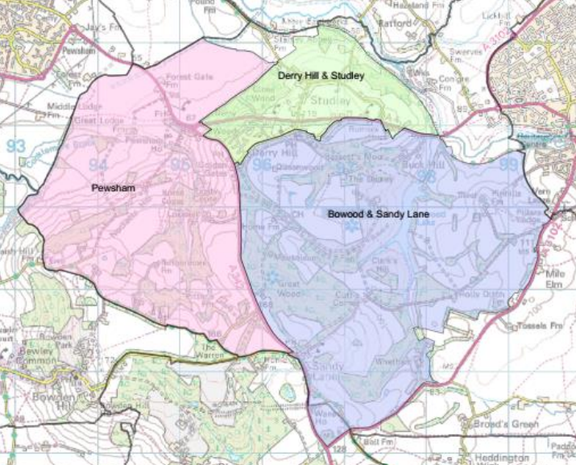
1. Vacancies – new Derry Hill & Studley Parish Council
3 Wards:
Derry Hill & Studley – 9 councillors
Bowood & Sandy Lane – 1 councillor
Pewsham – 1 councillor
All current councillors up for re-election

Slide 4
2. Election Timetable
Notice of Election Published | Tuesday 11th March 2025
Nominations hand delivered from | Wednesday 12th March 2025
Nomination Deadline | 4pm on Wednesday 2nd April 2025
Statement of persons nominated | 4pm on Thursday 3rd April 2025
Polling Day 7am to 10pm | Thursday 1st May 2025
Election Count | Friday 2nd May 2025
Existing councillors retire and new councillors take office | Tuesday 6th May 2025
Deadline for return of Election Expenses (town & parish) | Thursday 29th May 2025

Slide 5
3. Resources
Wiltshire Council Electoral Services
https://www.wiltshire.gov.uk/local-elections
Email: elections@wiltshire.gov.uk
Tel: 0300 456 0112
Address: Electoral Services, Wiltshire Council, County Hall, Bythesea Road, Trowbridge, BA14 8JN
Ward Maps & timetables can be found under:
Derry Hill & Studley Ward: https://elections.wiltshire.gov.uk/Home/Division/8965
Bowood & Sandy Lane Ward: https://elections.wiltshire.gov.uk/Home/Division/8964
Pewsham Ward: https://elections.wiltshire.gov.uk/Home/Division/8966
Notices and further links will be published in these locations.
Electoral Commission
Detailed guidance for town and parish council elections in England can be found under:
https://www.electoralcommission.org.uk/guidance-candidates-parish-council-elections-england
Link to Nomination Papers can be found under here or at:
https://www.electoralcommission.org.uk/sites/default/files/2025-01/Nomination%20pack%20PARISH.docx
(The link may also be posted on Wiltshire Council’s site from 11th March.)

Slide 6
4. Candidate Qualifications and Disqualifications
Qualifications
At least 18 years old at the time of nomination;
Be a British citizen, an eligible Commonwealth citizen, a citizen of the Republic of Ireland, a qualifying EU citizen or an EU citizen with retained rights;
• AND at least one of the following:
– On the electoral register in the parish council area;
– Have occupied as owner or tenant any land or premises in the parish council area for whole 12 months prior to nomination;
- Have had your principal or only place of work in the parish council area for whole 12 months prior to nomination.
– Have resided in the parish council area or within 3 miles of it for whole 12 months prior to nomination.

Slide 7
4. Candidate Qualifications and Disqualifications
Disqualifications
Must not be employed by the parish council or hold a paid office under the parish council.
Must not currently be subject of a bankruptcy restrictions order or interim order.
Sentenced to a term of imprisonment of three months or more within the last five years (included suspended sentences)
Disqualified under the Representation of the People Act 1983 (which covers corrupt or illegal electoral practices)
Subject to the notification requirement of or under Part 2 of the Sexual Offences Act 2003
Been convicted of an intimidatory criminal offence motivated by hostility towards a candidate, future candidate or campaigner or holder of a relevant elective office (five year disqualification).

Slide 8
5. Nomination Papers
1a - Nomination paper
1b - Home address form
1c – Candidate’s Consent to nomination
2 - Certificate of Authorisation – for Political Party candidates only
3 - Request for a Party Emblem - – for Political Party candidates only
Print in full.
Submit in full (even including blank pages)
Sign using black ink and wet signatures – no electronic signatures or photocopies
Parish of = Derry Hill and Studley
Date of Election = Thursday 1st May 2025
Election Agent - there is no formal role of Election Agent in Town & Parish Council Elections

Slide 9
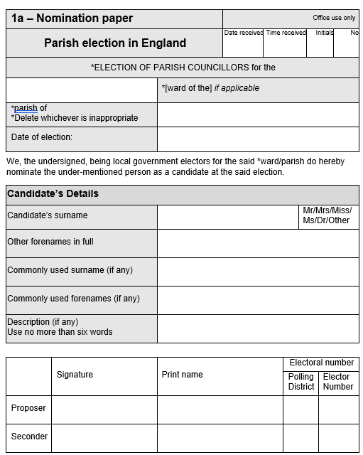
5. Nomination Papers – 1a Nomination paper
Forenames must be given in full.
Commonly used names – these are optional. Could choose to use a professional name instead of surname, drop a forename or use a shortened forename. These boxes allow you to choose how your name appears on the ballot paper.
Description – can either leave blank; use “independent”; use a description of no more than 6 words. (Or use Party name if standing as an authorised Party candidate.)
Proposer and Seconder:
Must be registered as an elector in the Ward.
Print name as it would appear in the electoral register (e.g. “John S Doe”)
Can leave Electoral Number blank and ask Electoral Services to enter it when you submit your papers (but take a note of their addresses with you).

Slide 10
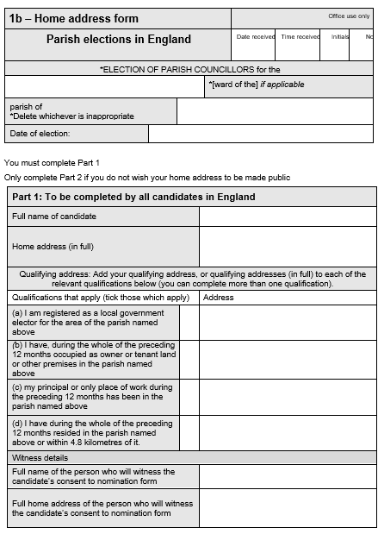
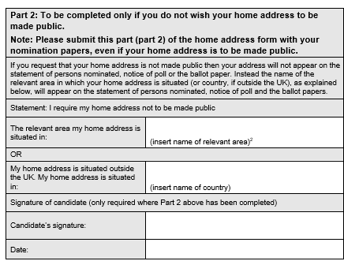
5. Nomination Papers – 1b Home Address Form
All candidates must complete part 1
Candidates may complete part 2 if they wish to withhold their full home address from publication on the ballot paper and statement of persons nominated. This is a personal choice.
The “relevant area my home address is situated in” will be “Wiltshire”

Slide 11
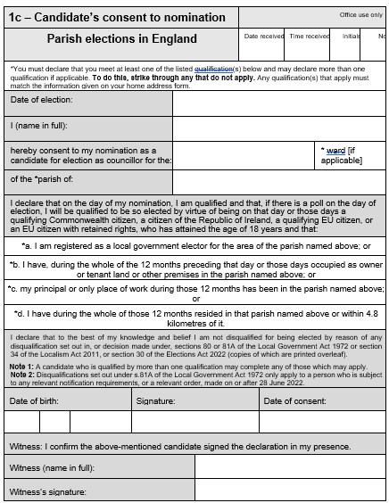
5. Nomination Papers – 1c Consent to Nomination
Legally binding declaration by the candidate that they are qualified and not disqualified
Can be witnessed by anyone, but you will need to give the full name and address of the witness in 1b.
Must be dated between the 12th March and 2nd April (when nominations are open).

Slide 12
5. Nomination Papers – submitting
Nomination papers must be delivered by hand to Wiltshire Council’s Election Services team at Monkton Park offices in Chippenham.
Appointment slots will be available between 10am and 4pm each working day from Wednesday 12th March. These can be booked online. (There will be a link added to the Wiltshire Council local elections website.)
Officers will carry out an informal check of your papers if asked. Allow enough time for this.
The deadline for submitting nomination papers is 4pm on Wednesday 2nd April. Don’t leave it to the last minute!

Slide 13
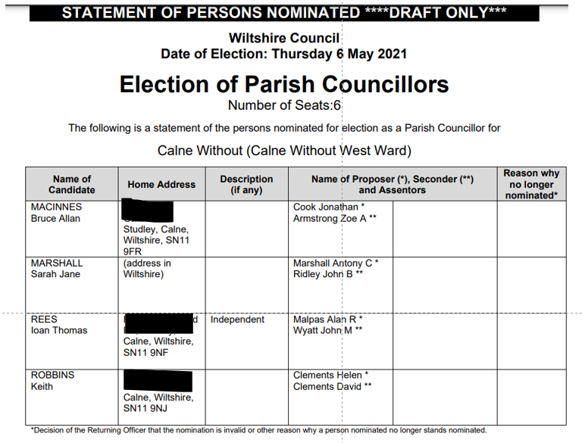
6. The Statement of Persons Nominated
This will be published on Wiltshire Council’s website on Thursday 3rd April and will be a list of all Candidates for that specific election.
At this point you may find out you have been elected unopposed.
(Alternatively, you will find out who will be on the ballot paper.)

Slide 14
7. Campaigning
Imprints:
Required by law on all printed communications (e.g. leaflets) and now by law on electronic communications (e.g. websites, Facebook pages).
3 part imprint: Promoted by…on behalf of…….Printed by…….
Example: Promoted by John Smith, on behalf of Jane Smith of 112 High Street, Airdrie, AD1 1AD. Printed by Armadillo Printing Ltd, 22 Thornfields Avenue, Glasgow, G9 1AB.
Also:
Specific election offence of making false statements about the conduct or character of a candidate, and civil law – defamation - also applies to campaign material.
Keep a track of all election expenses and file receipts.
Specific election offence of making false statements about the conduct or character of a candidate, and civil law – defamation - also applies to campaign material.
Code of Conduct for Campaigners - https://www.electoralcommission.org.uk/code-conduct-campaigners-uk-parliamentary-general-elections-great-britain-local-elections-england

Slide 15
8. Polling Day and The Count
Polling Day:
Polling Day will be Thursday 1st May 2025.
Our Polling Station will be in the Lansdowne Hall. Polling will open at 7am and close at 10pm.
(Postal votes will be sent out to postal voters from approx. 14th April.)
The Count:
Wiltshire Council will be holding the Count on Friday 2nd May at the Olympiad.
Candidates may attend the Count with one spouse/friend/guest and a limited number of “counting agents”.
Electoral Services will be in contact with candidates about registering counting agents.
Results will be published on Wiltshire Council’s website following the Count.

Slide 16
9. Election Expenses
Spending is capped between 25th March 2025 and 10pm on polling day – known as the short campaign.
The spending limit is £960 + 8p per registered local government elector in the ward/division contested. (This is a limit not a target!)
Written confirmation of the Spending Caps in each ward will be published on Wiltshire Council’s website.
Covers any spending to promote the candidate during the short campaign. Keep and file receipts as you go. Volunteer time is not an election expense.
An Expenses Return and Declaration must be submitted to Wiltshire Council by Thursday 29th May 2025. Details can be found here: https://www.electoralcommission.org.uk/guidance-candidates-parish-council-elections-england/after-election/completing-your-return
Complete a return even if your Expense were “NIL”, and even if the election was uncontested.

