Slide 1
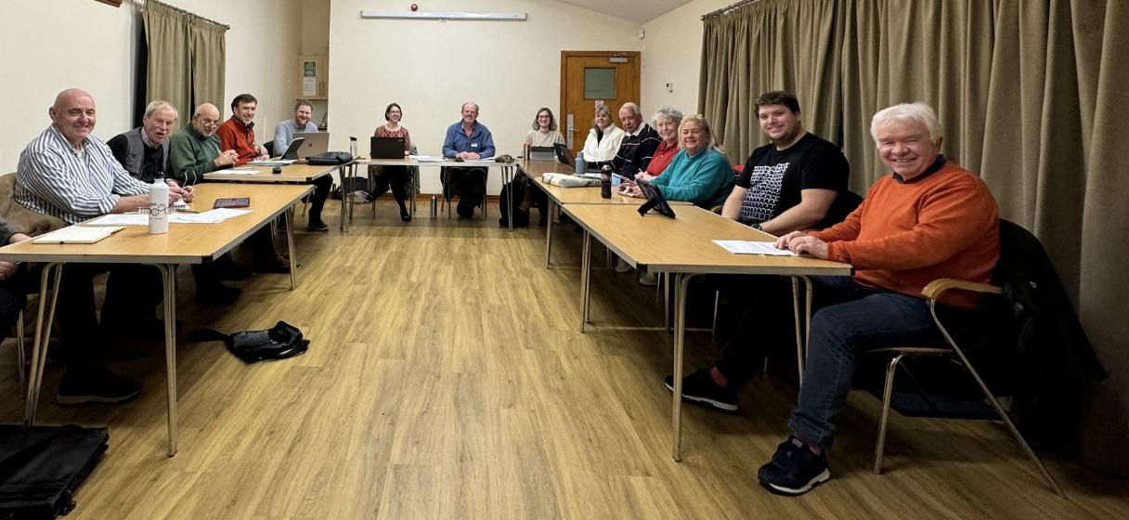
Chair’s Report
Wednesday 5th March 2025

Slide 2
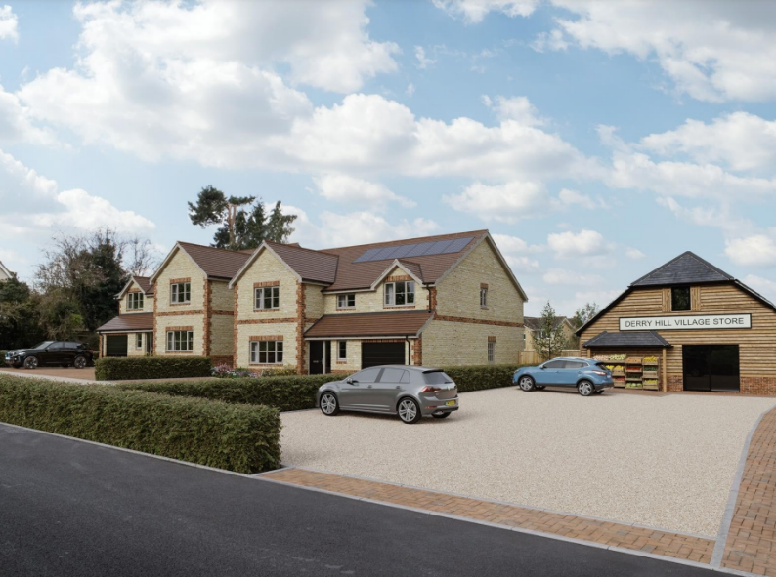
Planning Applications
The Parish Council is a statutory consultee on all planning applications within the parish. We review all planning applications and seek improvements where appropriate.
Examples from 2024/25 include:
Sands Farm Solar Farm
48-49 Church Road, Derry Hill (shop)
Land off Spitfire Road
Bethesda Care Home

Slide 3
Calne Community Neighbourhood Plan
Calne Community Neighbourhood Plan first “made” in 2018. Plan has been under major review since 2021.
Approved on 27th February 2025 by Referendum, with 92.5% of the vote,
Local Planning Policies on:
Climate change & sustainable development
Natural Environment
Built Environment
Community Facilities
Getting Around
Working & Shopping
Housing & Infrastructure
+ Local Design Guide
“The Plan is an excellent example of a neighbourhood plan review”
Independent Examiner

Slide 4
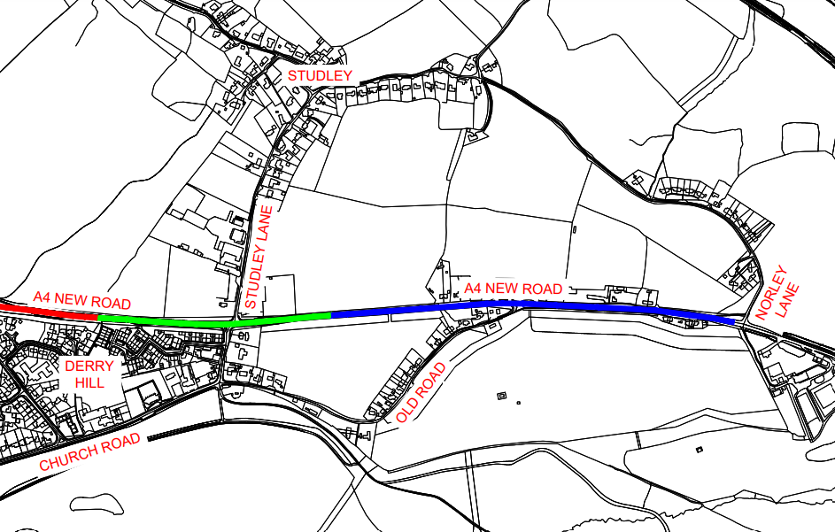
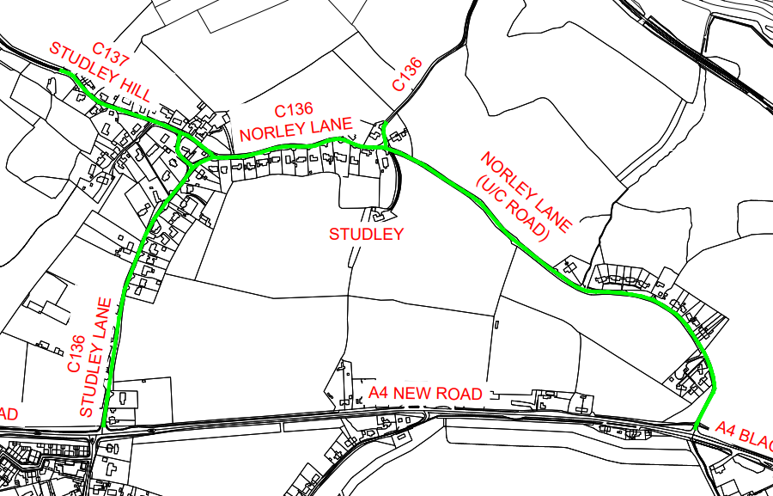
Road Safety Working Group
Proposed 20mph Speed Limit for Studley & Norley Lane approved Feb’25.
40mph through Studley Crossroads & 50mph east to Norley Lane implemented Oct’24.

Slide 5
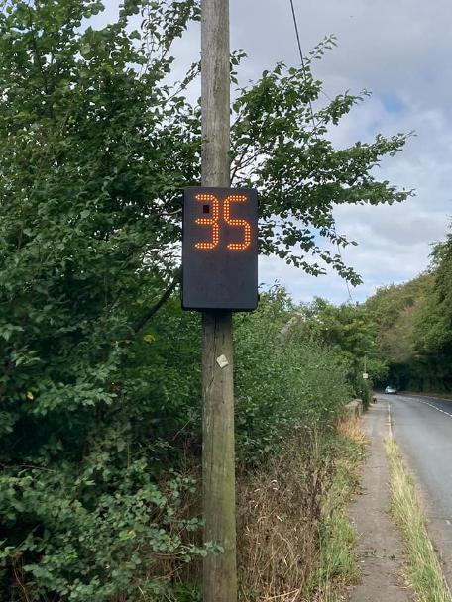
Road Safety Working Group
White Gates and Signage Improvements installed at Sandy Lane.
Crash Barrier extended at the bottom of Old Derry Hill.
The Council’s two Speed Indicator Devices continue to be rotated around the parish with data supplied to Wiltshire Police to inform speed enforcement.
Engagement with Derry Hill School about parking during drop-off and pick-up times.
A3102 Safer Roads Project – reduction in speed limit on A3102 Mile Elm Road and safety improvements (white lining, signage improvements)
Awaiting outcome of two bids to Wiltshire Council for substantive scheme funding:
Surfacing of the shared use path between the Lansdowne Hall and the A4
Traffic Calming Improvements on Church Road & Studley Lane

Slide 6
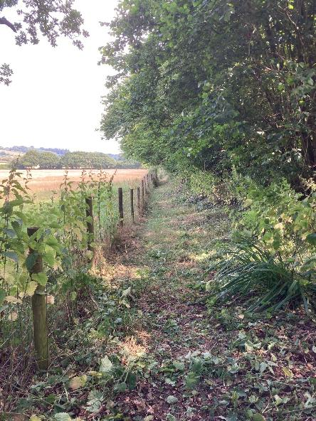
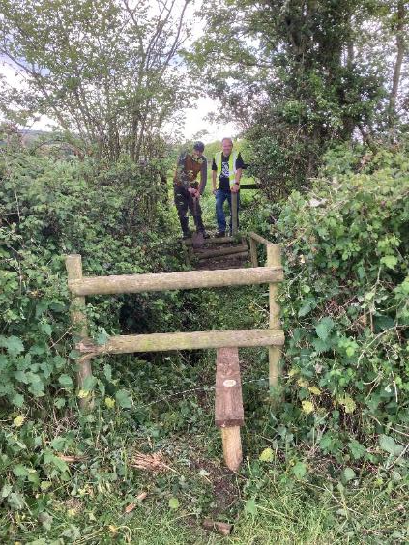
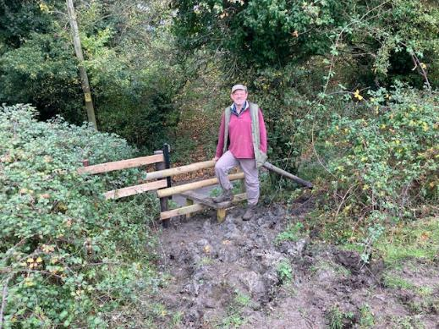
Footpaths Working Group
The Footpaths Working Group has continued to undertake maintenance and improvement works to the Parish Councils 80km of public rights of way.
Over the past year this has included:
Stiles on CALW49 & CALW52 at Stockley Common
Stiles on CALW87 Naish Hill near Nethermore Farm
Repairs to steps on CALW82 to west of the Lansdowne Arms
Clearance/strimming on CALW86 Close Wood
Handrail repairs – CALW13, CALW67, CALW80
Stile repairs on CALW42 at Calstone & CALW49 Stockley

Slide 7
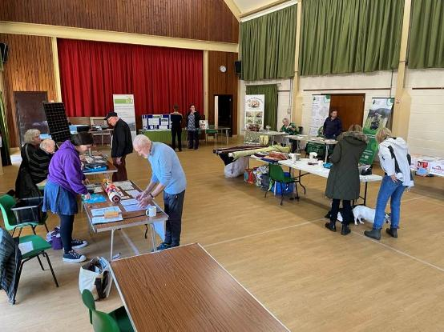
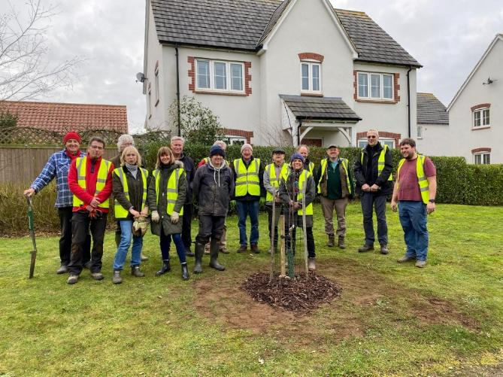
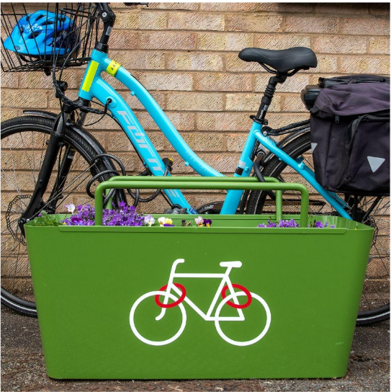
Climate and Environment Working Group
Studley Gardens Community Orchard planted.
Coming Soon!
Bicycle Stand Planters
Sustainability & Wellness Weekend 19/20th October (in conjunction with the Community Committee)
Grant funded from Coronation Living Heritage Fund.

Slide 8
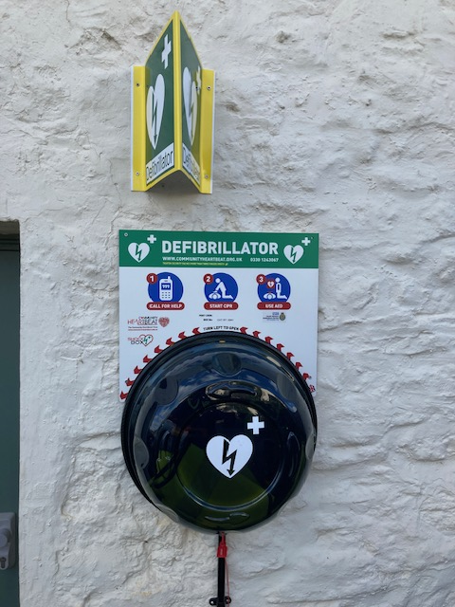
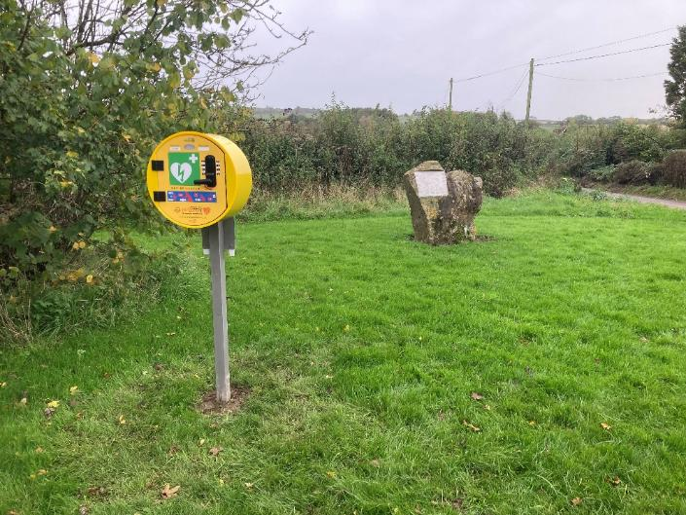
Community Defibrillator Project
Parish Council Project to install community defibrillators to every community not currently covered:
Calstone – installed
Compton Bassett x 2 – installed
Cherhill View – planned
Mile Elm - planned
Sandy Lane – planned
The Pewsham – installed

Slide 9
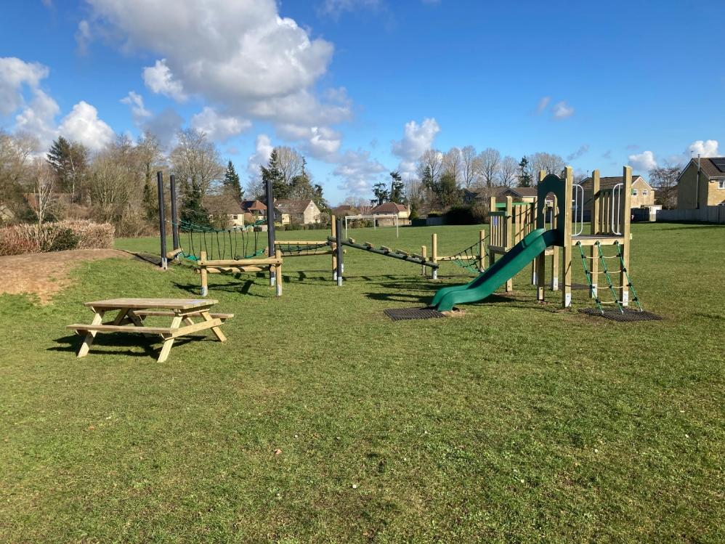
Play Equipment on Petty Acre
New play equipment on Petty Acre – first public play equipment in Derry Hill!

Slide 10
Thanks to councillor colleagues and the Parish Clerk

Slide 11
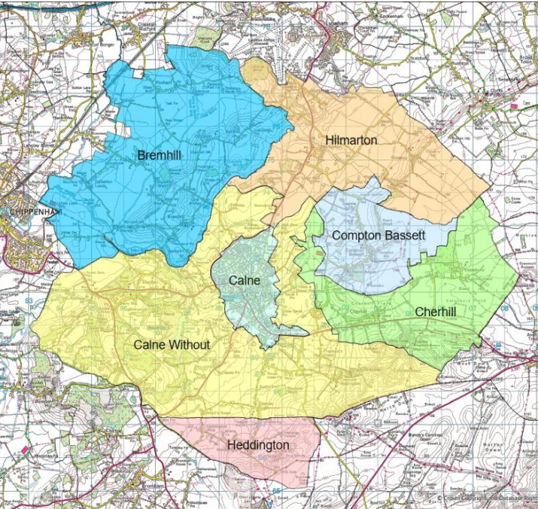
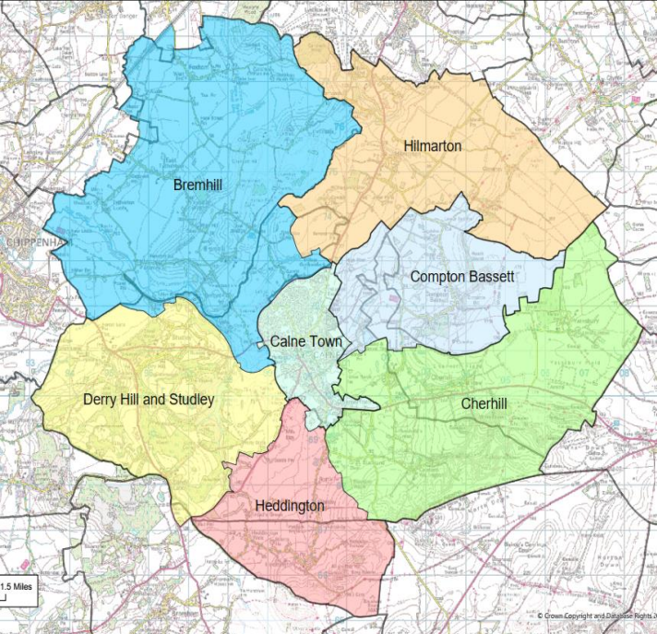
Community Governance Review
In May, the parish boundaries change and we will become Derry Hill & Studley Parish Council.
1st May – Parish Council Elections– could you make a difference to our community?

